Slide 1
Intro to ML with Images
Fernando J. Quintero
2024

Slide 2
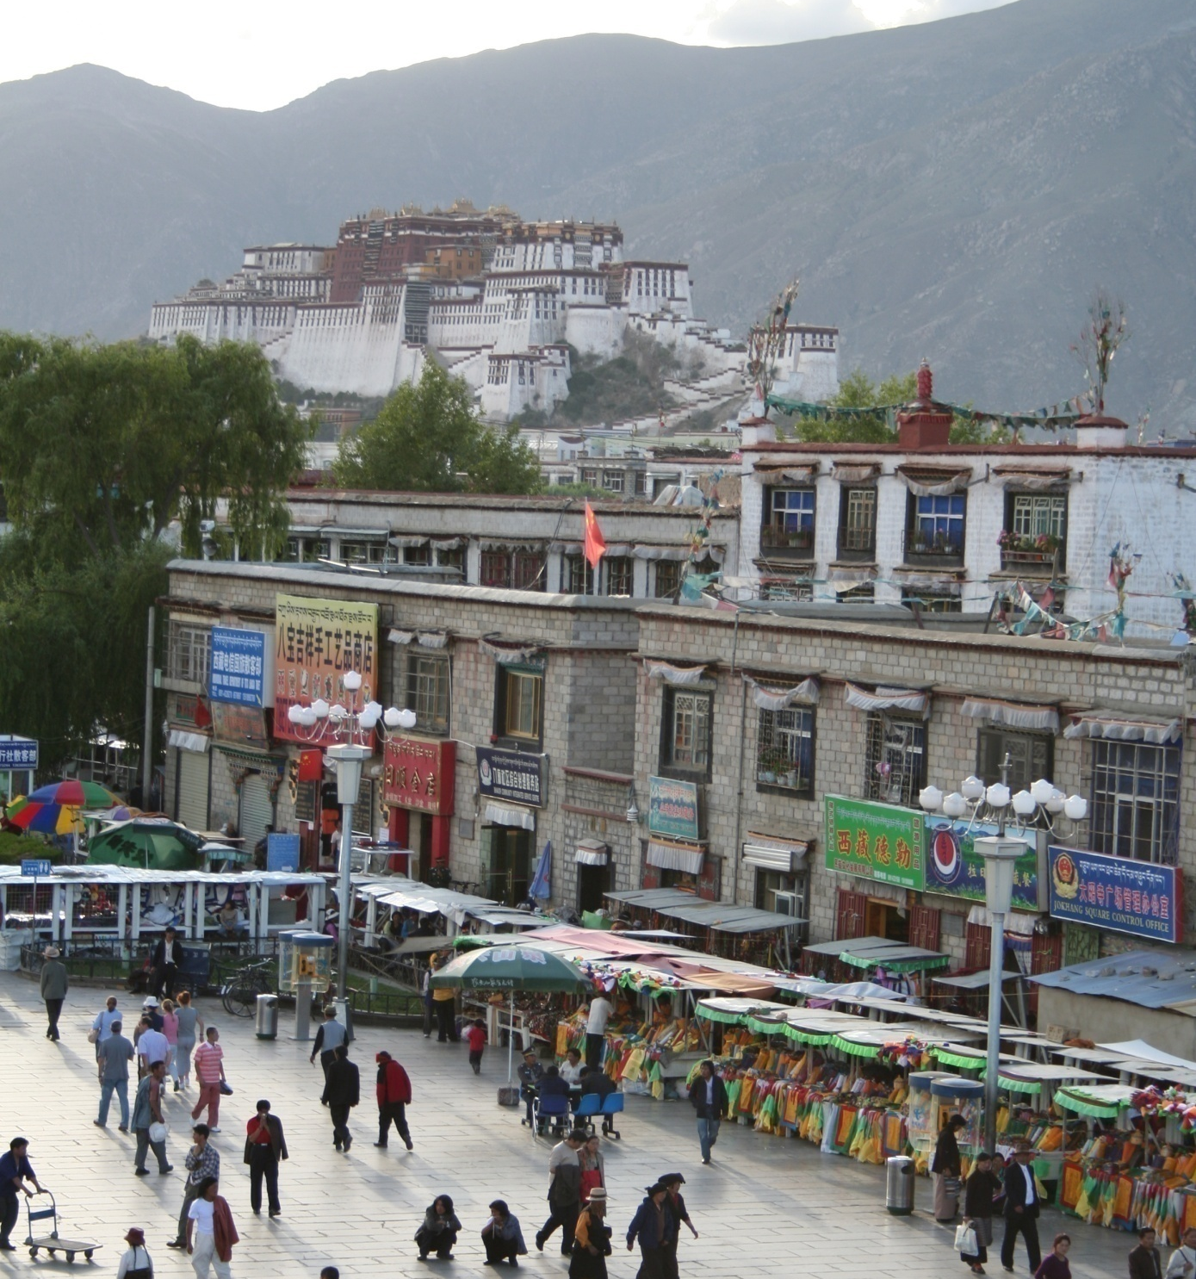
Common recognition tasks

Slide 3
Image classification and tagging
outdoor
mountains
city
Asia
…

Slide 4
Image description
This is a busy street in an Asian city. Mountains and a large palace or fortress loom in the background. In the foreground, we see colorful souvenir stalls and people walking around and shopping. One person in the lower left is pushing an empty cart, and a couple of people in the middle are sitting, possibly posing for a photograph.

Slide 5
Object detection
Find pedestrians

Slide 6
Activity recognition
walking
shopping
rolling a cart
sitting
talking
…

Slide 7
Semantic segmentation
sky
mountain
building
tree
building
lamp
lamp
umbrella
umbrella
person
person
market stall
person
person
person
person
person

Slide 8
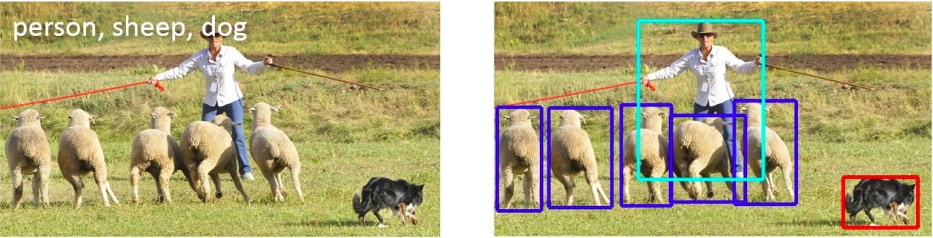
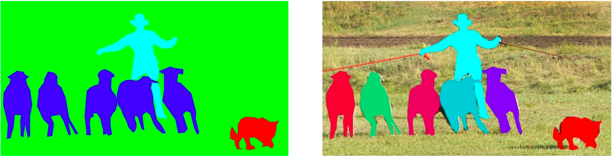
Detection, semantic segmentation, instance segmentation
image classification
object detection
semantic segmentation
instance segmentation

Slide 9
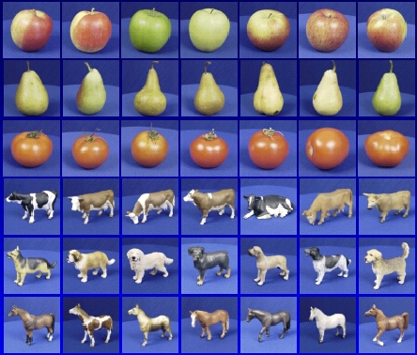
Image classification

Slide 10
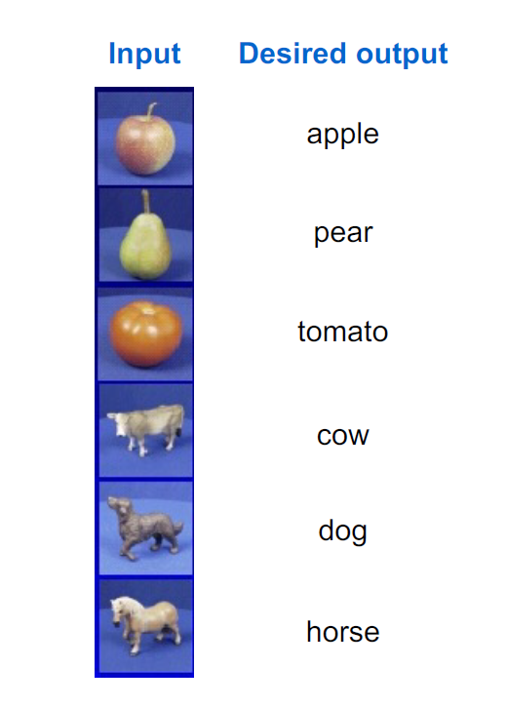
Image classification

Slide 11



Image classification
Apply a prediction function to a feature representation of the image to get the desired output:
f( ) = “apple”
f( ) = “tomato”
f( ) = “cow”

Slide 12
Image classification
y = f(x)
Training: given a training set of labeled examples
{(x₁,y₁), …, (x_{N},y_{N})}, estimate the prediction function f by minimizing the prediction error on the training set
Testing: apply f to a never before seen test example x and output the predicted value y = f(x)
output
prediction function
feature representation

Slide 13

Training
Training Labels
Training Images
Image Features
Training
Learned model
Learned model
Testing
Image Features
Prediction
Test Image

Slide 14
Recognition: What type of output?
Classification: labels
Regression: continuous values
Dense prediction: an output at every image location
Structured prediction: combinatorial structures
Natural language
Etc.

Slide 15
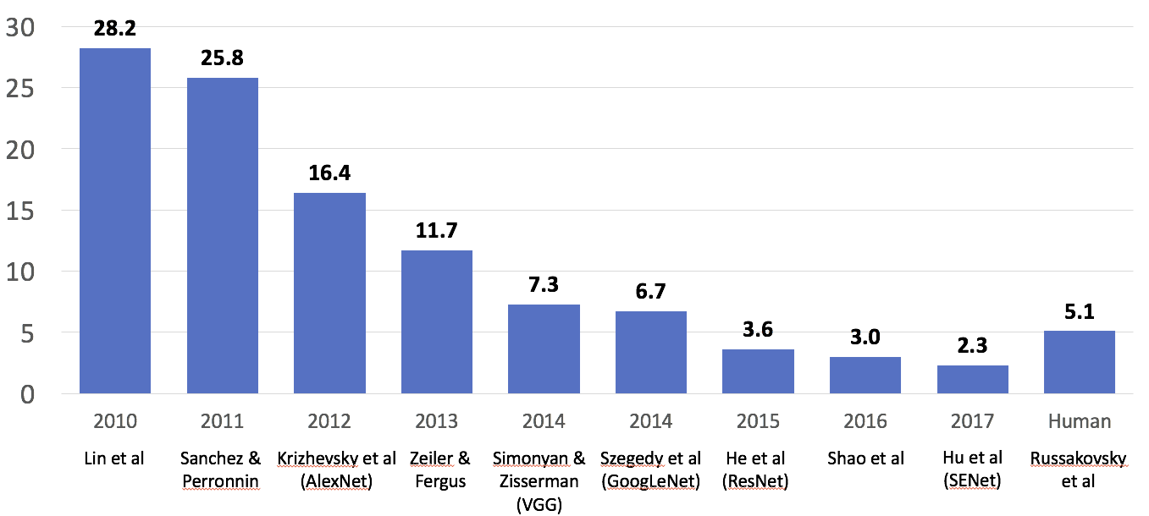
Classification
ILSVRC
Enter deep learning
Figure source

Slide 16
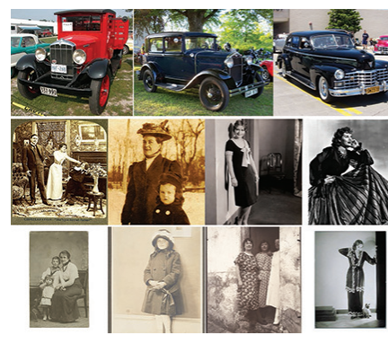
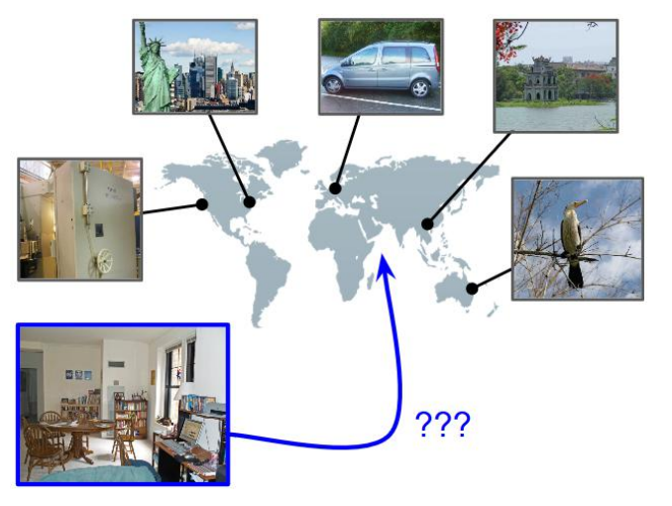
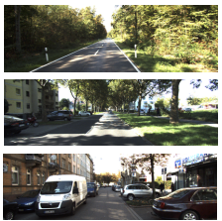
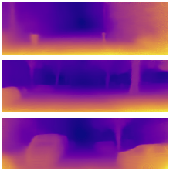
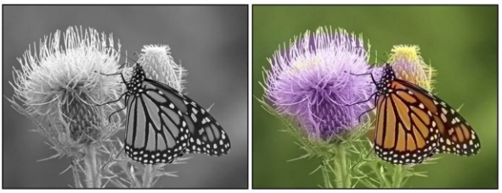
Regression
Date prediction
Location prediction
Vittayakorn et al. (2017)
Vo et al. (2017)
Depth prediction
Image colorization
Zhang et al. (2016)
Wang et al. (2017)

Slide 17
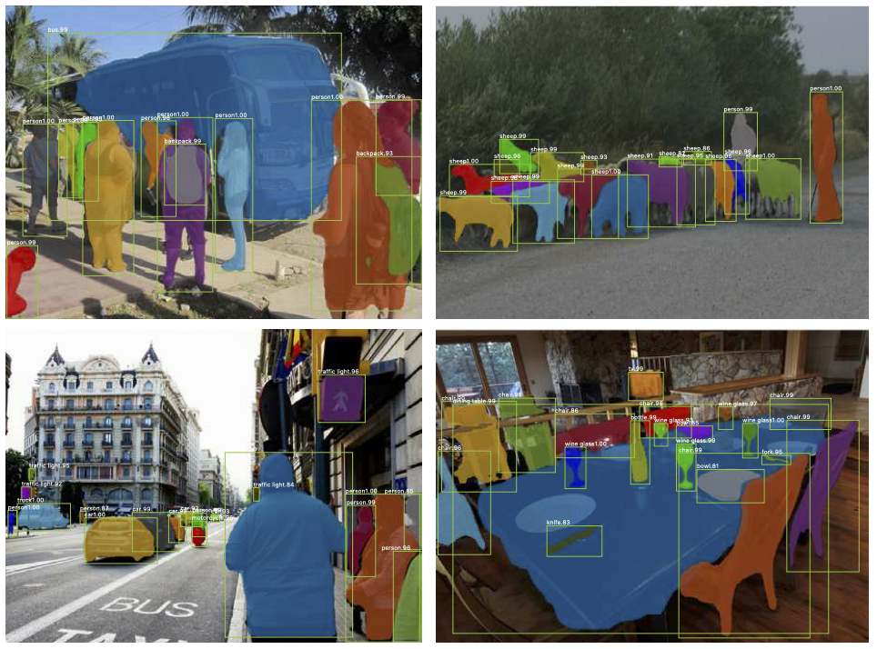
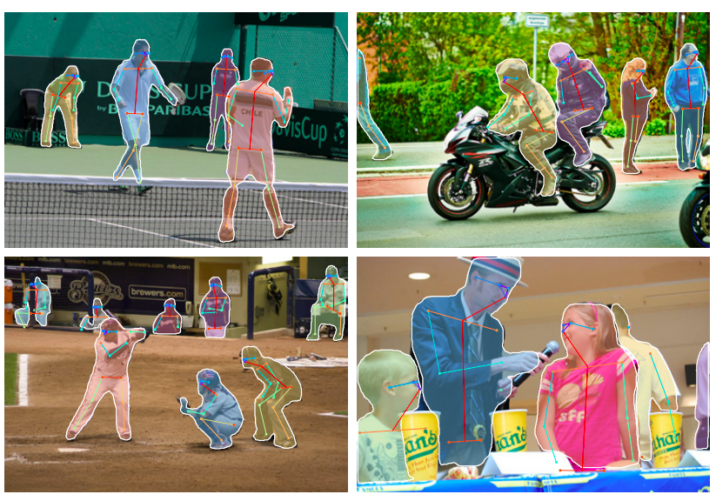
Dense and structured prediction
Bounding box prediction,
dense prediction
Keypoint prediction
K. He, G. Gkioxari, P. Dollar, and R. Girshick, Mask R-CNN, ICCV 2017

Slide 18
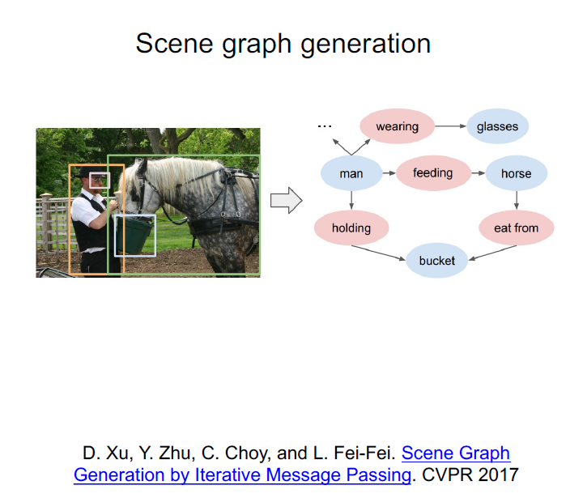
Dense and structured prediction

Slide 19
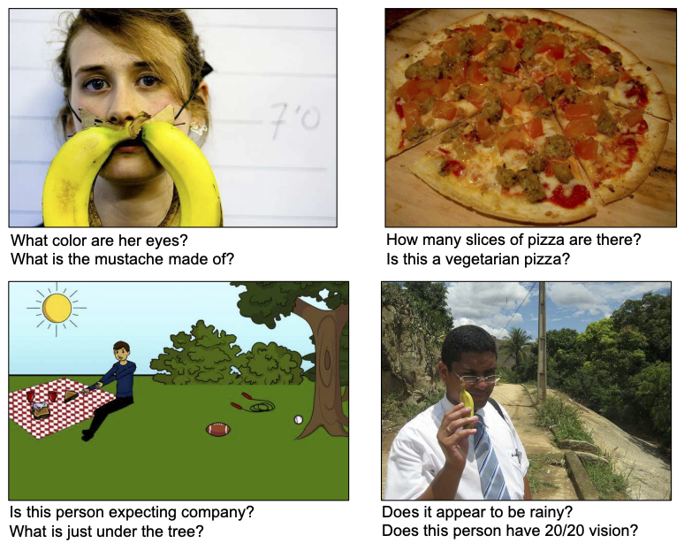
Natural lenguage prediction
Image captioning
Visual question answering
A. Karpathy, L. Fei-Fei. Deep Visual-Semantic Alignments for Generating Image Descriptions. CVPR 2015
S. Antol et al. VQA: Visual question answering. ICCV 2015

Slide 20
Recognition: What type of supervision?
Semi-supervised:
labels for a small portion of training data
Weakly supervised: noisy labels, labels not exactly for the task of interest
Supervised:
clean, complete training labels for the task of interest
Unsupervised: no labels
Self-supervised:
same as unsupervised?

Slide 21
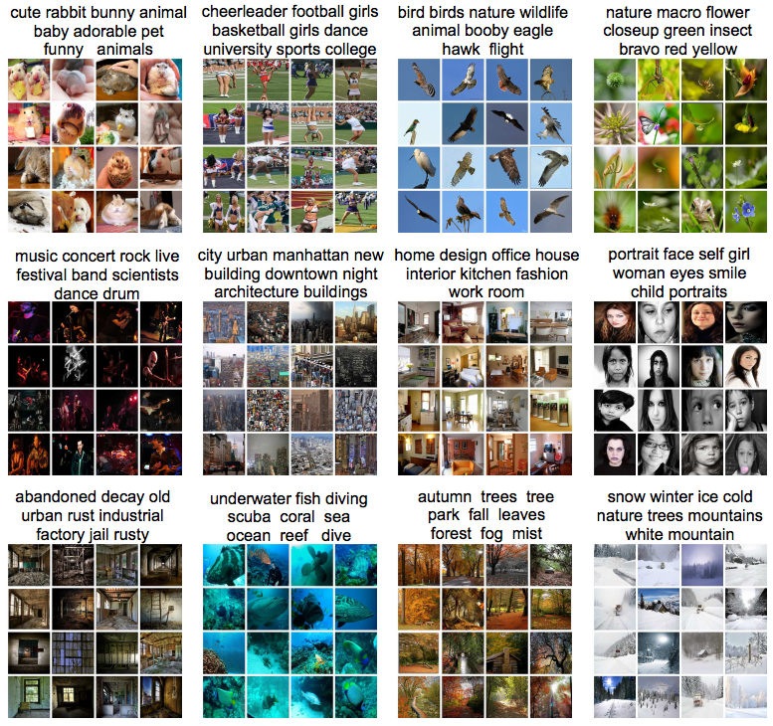
Unsupervised learning
Clustering
  Discover groups of “similar” data points
Y. Gong, Q. Ke, M. Isard, and S. Lazebnik. A Multi-View Embedding Space for Modeling Internet Images, Tags, and Their Semantics. IJCV 2014

Slide 22
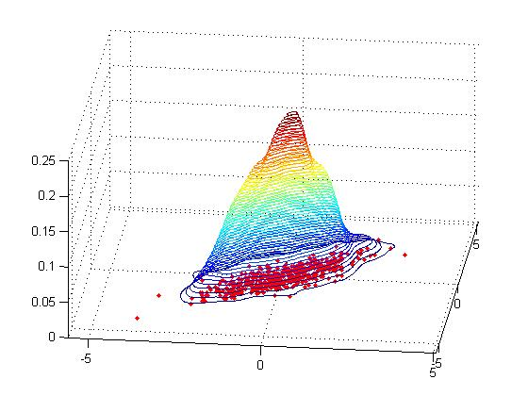
Unsupervised learning
Learning the data distribution
  Density estimation: Find a function that approximates the probability density of the data (i.e., value of the function is high for “typical” points and low for “atypical” points)
  An extremely hard problem for high-dimensional data…

Slide 23
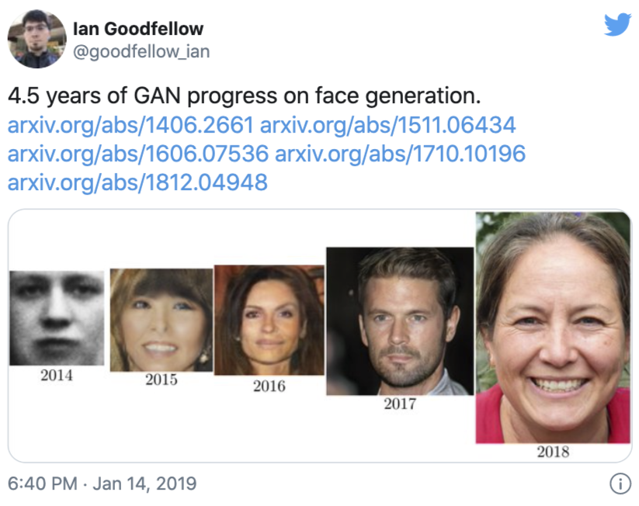
Unsupervised learning
Learning the data distribution
  Learning to sample: Produce samples from a data distribution that mimics the training set
Generative adversarial networks (GANs)

Slide 24
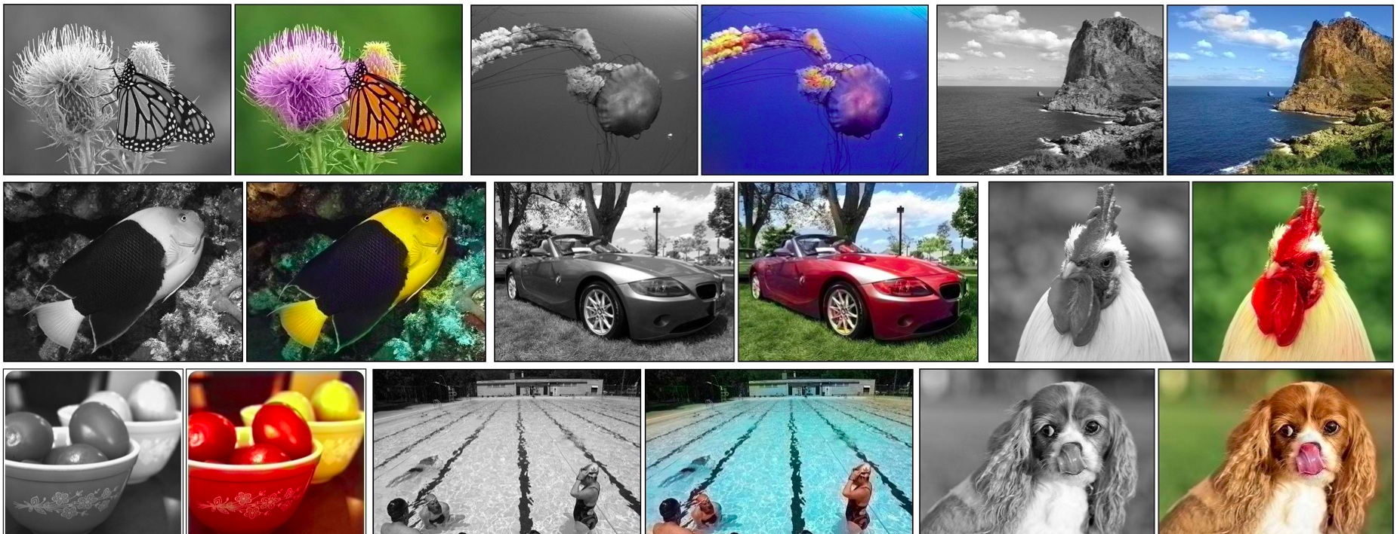
Self-supervised learning
Use part of the data to predict other parts of the data
  Example: Image colorization
R. Zhang et al., Colorful Image Colorization, ECCV 2016

